Slide 1

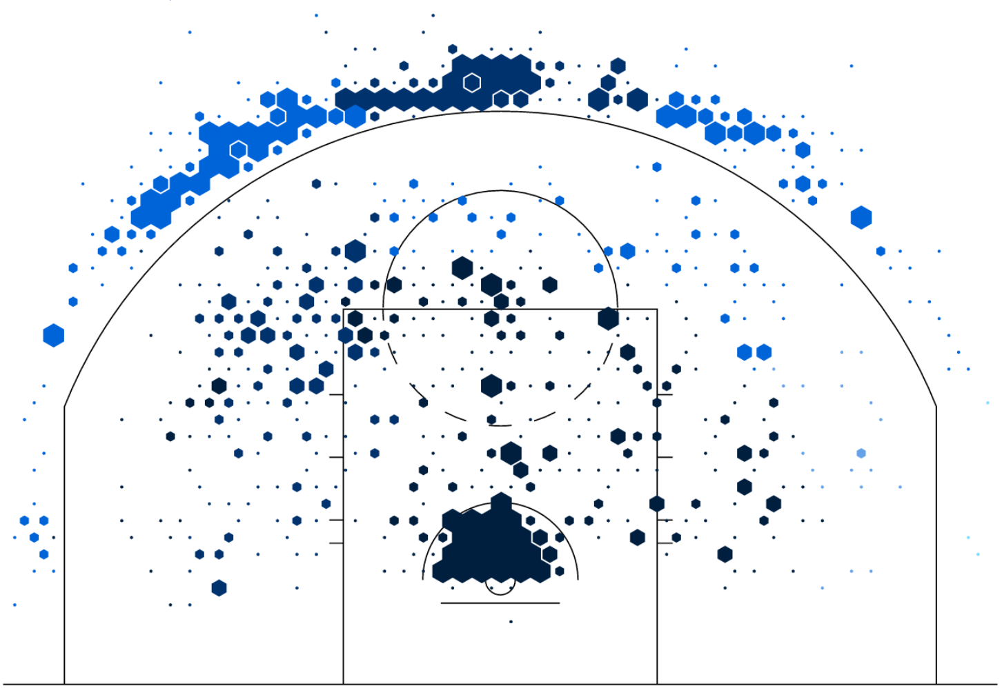
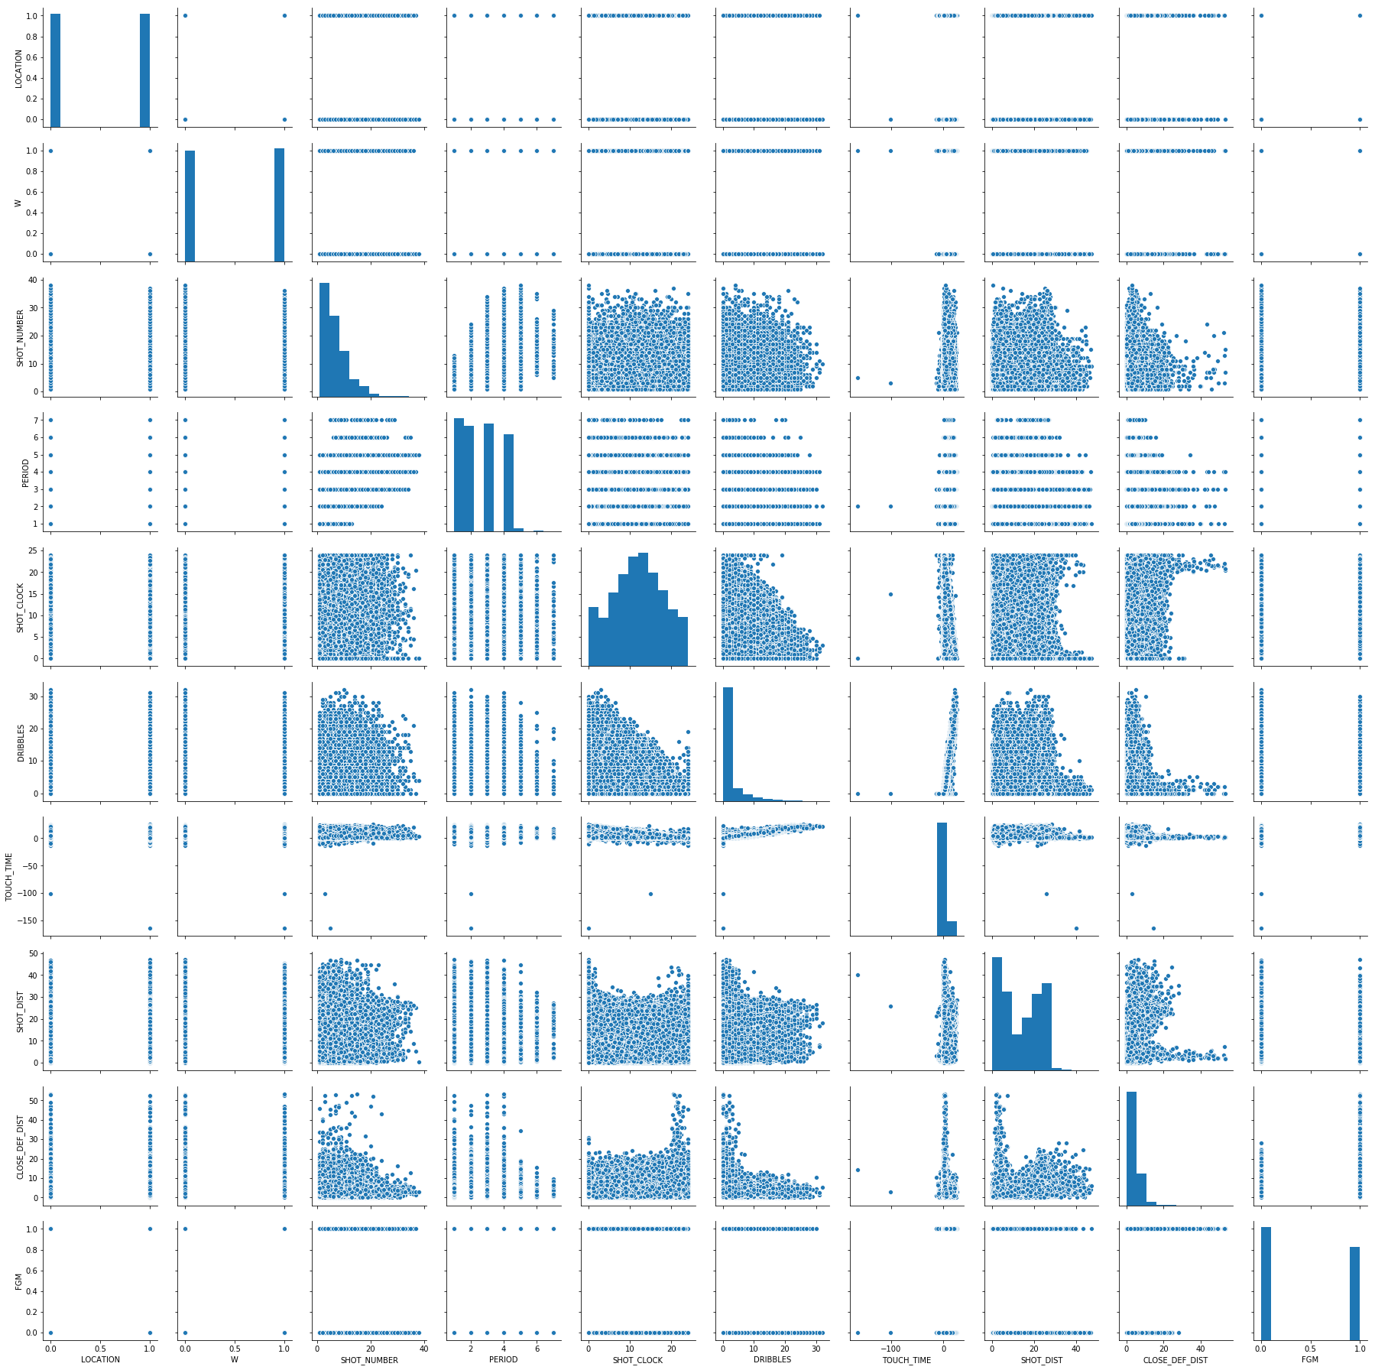
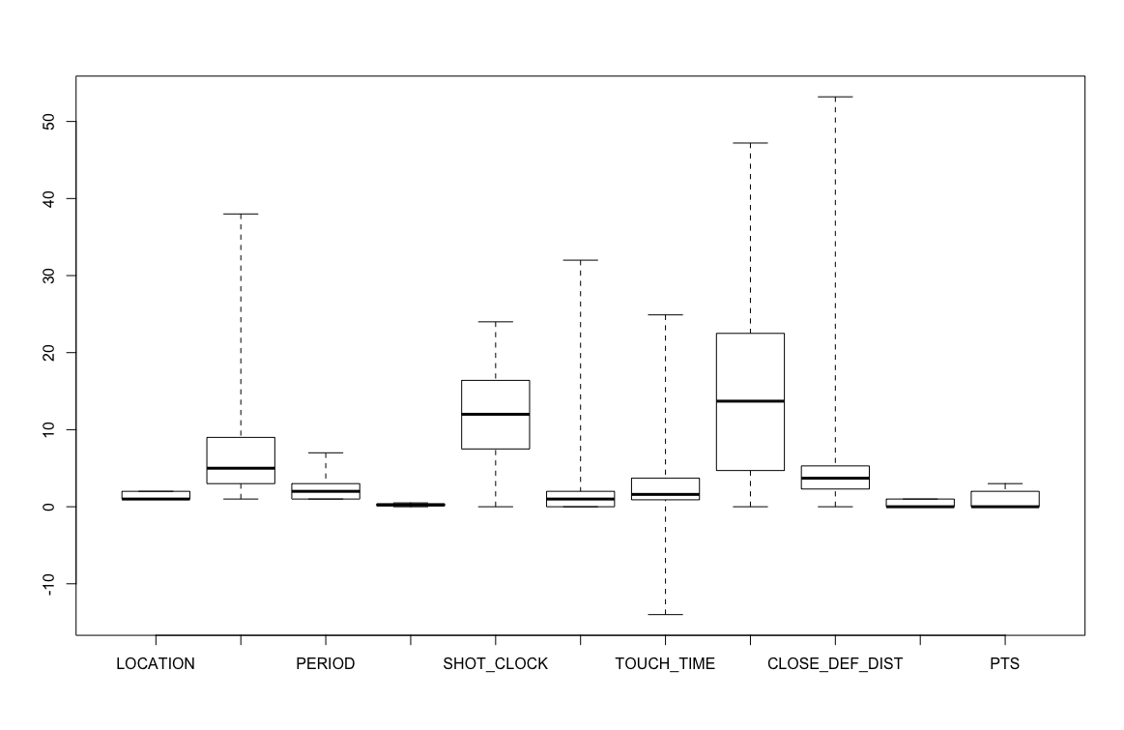
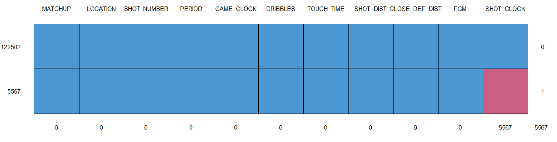
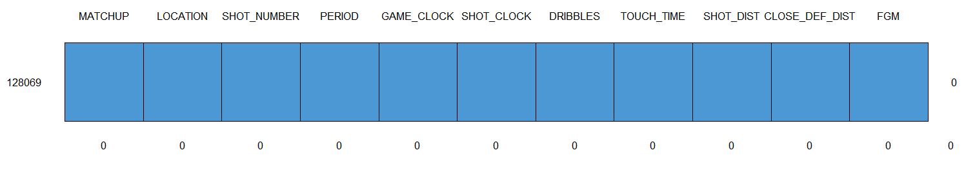
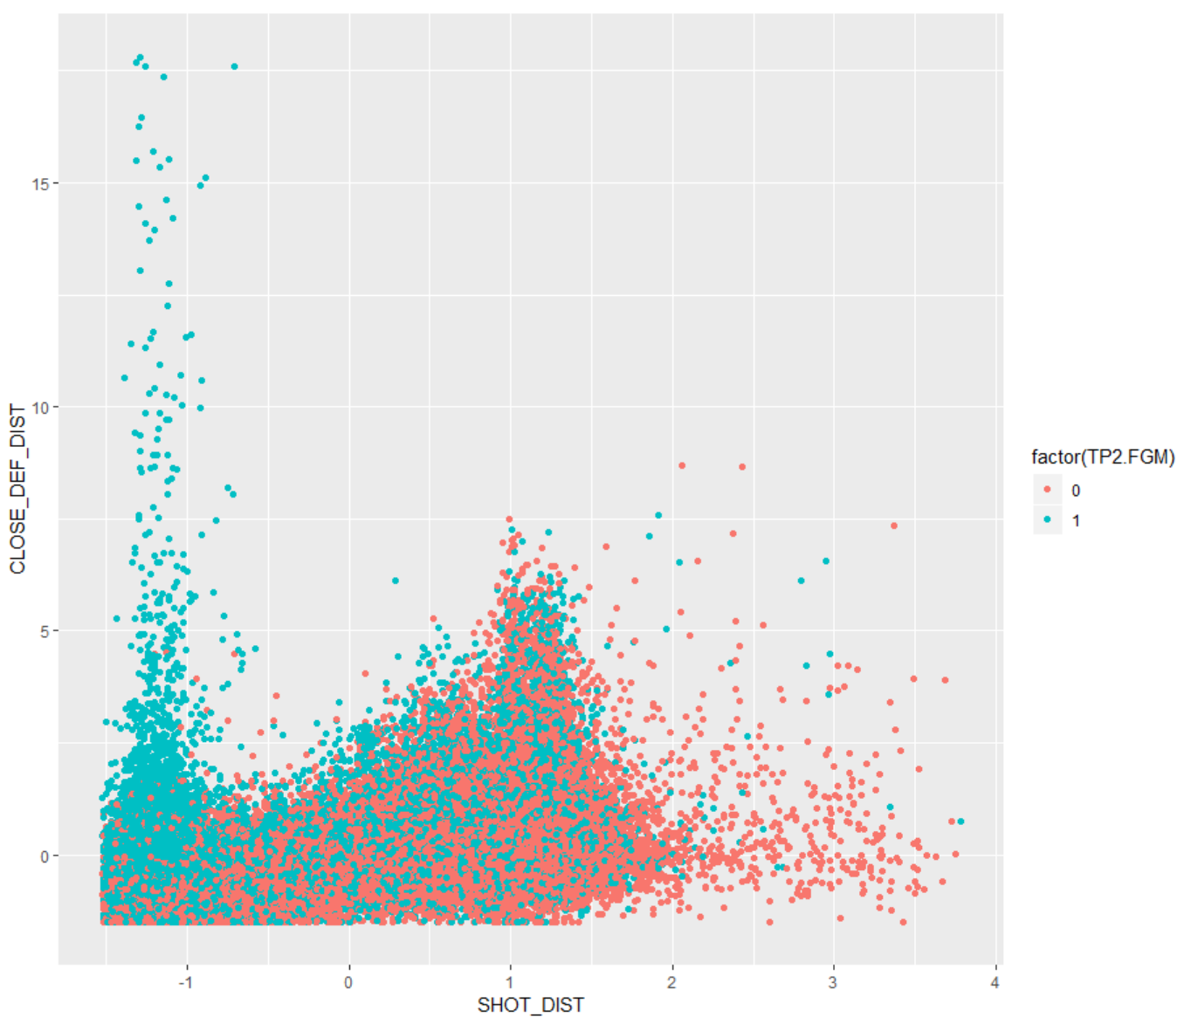
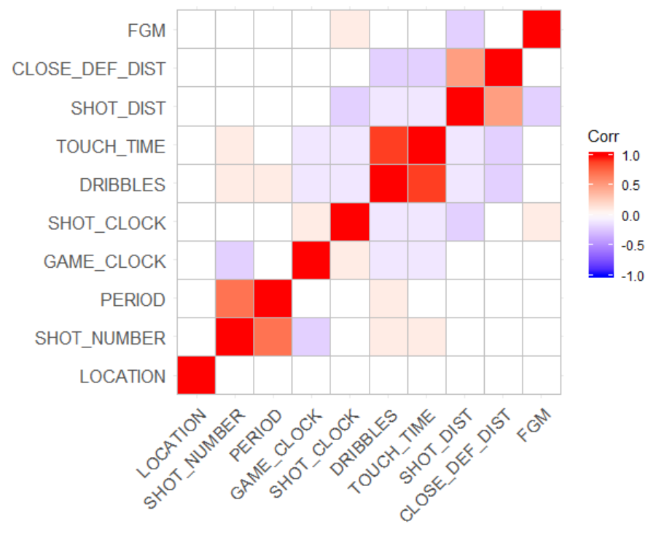
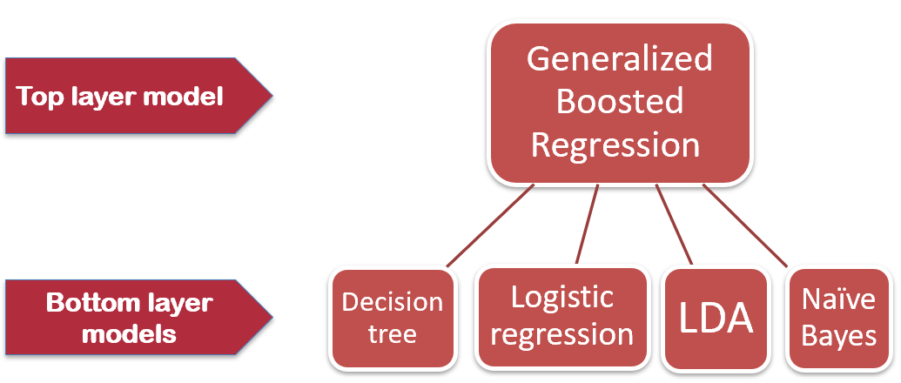
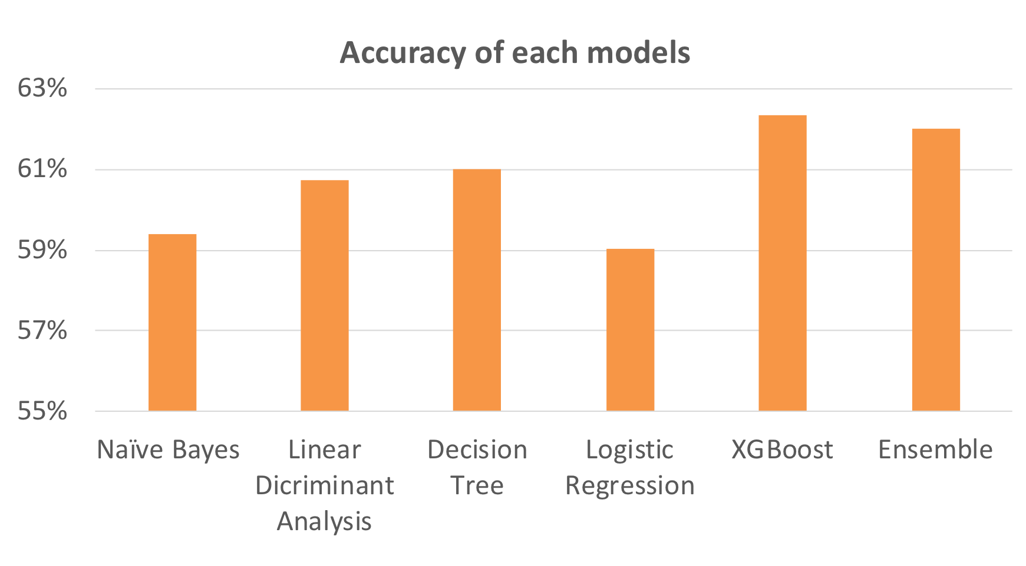
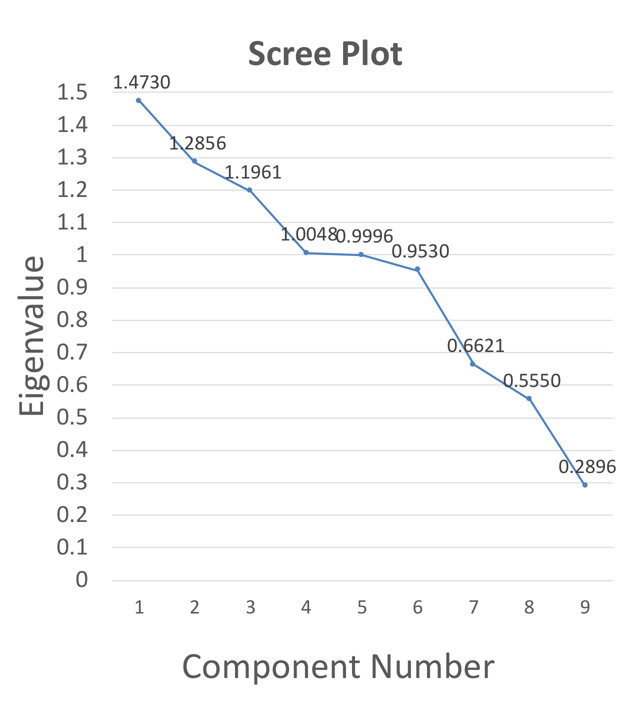
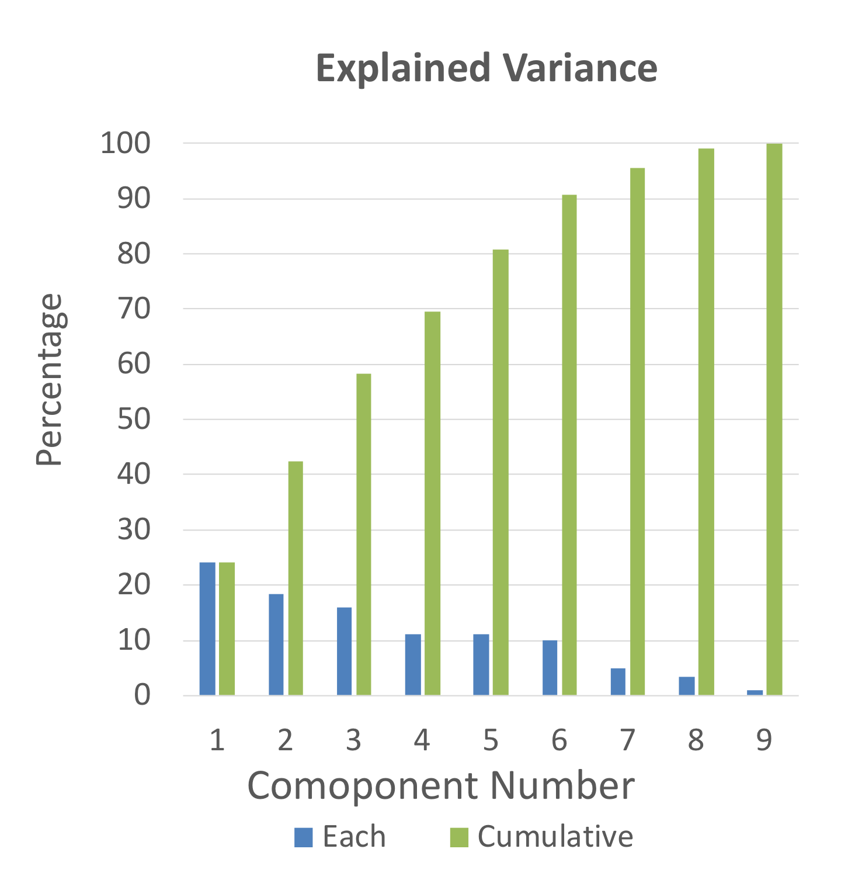
Predicting the outcome of a basketball shot
Team: Haitao Liu, Yang Liu, Jiawei Xue
Instructor: Amir H Gandomi
Business Intelligence & Analytics
Fall 2018
. Objectives
Use the data on shots taken during NBA 2014-2015 season to find the most important features that affect the shooting result
Build machine learning models to get the relationships between different features and the shooting result
Interpret the models to get insight about players’ shooting performance
Data Understanding
Using boxplot to find relationships between variables.
Further check the relationships between interested variables
Data processing
Using box plot to detect outliers of the variables, and replacing the outliers with average value of that feature.
Using heatmap to build a correlation matrix between different features of the dataset
Imputing Missing Values
We found the 5567 missing value in column SHOT_CLOCK
The reason these missing value exist is that the blanks means zero offense time. More specifically, when a player catch the ball, there’s no time left for shooting. So we replaced these blank value with zero.
Modeling
Split the dataset into the training and testing subsets in a ratio of 4:1
Create the prediction models on the training subset using Naïve Bayes, Linear Discriminant Analysis, Logistic Regression, XGBoost and Ensemble.
Validate the prediction results using the testing subset.
Principal Component Analysis
In order to reduce the number of variables without losing much of the information, we conduct principal component analysis with nine categories to achieve this goal.
Result & Future Work
The XGBoost perform the highest accuracy.
These models are not ideal enough and have a great potential to enhance their accuracy.
In the future, we will add more features to increase the accuracy of the model so that we can make more accurate prediction to give advices to teams for training, coaching, and making playing strategies.
http://www.stevens.edu/bia

